Slide 1

HireSense AI
AI-Powered Resume Analyzer & Smart Recruitment Platform
"Transforming Recruitment with Artificial Intelligence"
Presented by: Iqra Hussain

Slide 2


Problem Statement
Slow Manual Screening
Hidden Talent
Zero Feedback
Companies receive thousands of resumes — manual review is painfully slow
Recruiters miss qualified candidates buried in the pile
Candidates never know why their resume gets rejected
ATS Gatekeeping
Ignored Credentials
Resumes rejected by bots before HR ever sees them
Certificates overlooked & interview prep left to chance

Slide 3




Our Solution — HireSense AI
An intelligent AI platform built for both Candidates and HR Recruiters
Resume Intelligence
AI Coaching
ATS Score · Skill Gap · Resume Analysis
Resume Improvement · Interview Questions · Certificate Analysis
HR Command Center
Multilingual
Candidate Ranking · Comparison Dashboard · PDF Reports
English & Hinglish Support

Slide 4

System Architecture
Upload Resume
OCR Extraction
AI Analysis
PDF Dashboard
Powered by: PyMuPDF · EasyOCR · Groq / Gemini · Streamlit · Plotly · Python

Slide 5
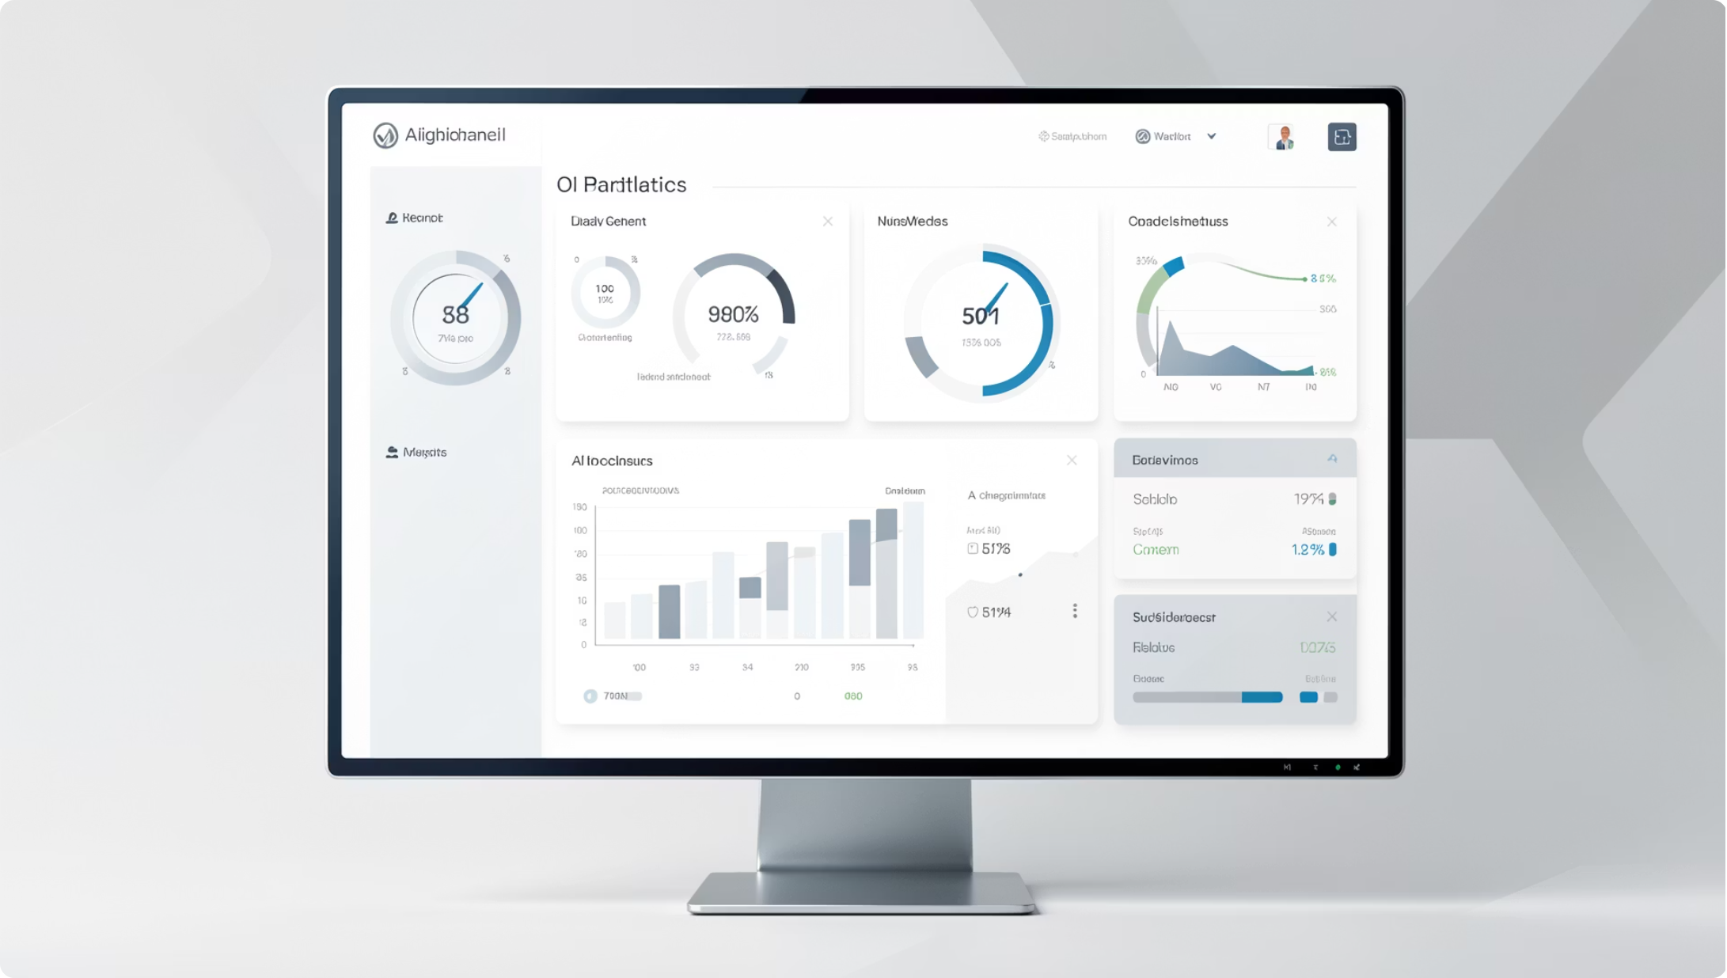

Candidate Dashboard
Upload & Configure
Resume · Job Role · Job Description · Certificates
Scores
ATS Score · Overall Score · Grammar & Communication
Deep Insights
Strengths · Weaknesses · Missing Skills · Suggestions
Export
Interview Questions · PDF Export

Slide 6


HR Dashboard
Bulk Upload
Upload ZIP of resumes — automatic parsing
Visual Analytics
Candidate Ranking · Charts · Graphs · Skill Comparison
Side-by-Side Compare
ATS Comparison · Candidate Comparison Table
Smart Shortlisting
Top Recommendations · Shortlist Generation · Interview Questions

Slide 7




AI Analysis Features
Parsing & OCR
Project & Cert Eval
Resume Parsing · OCR · Grammar Analysis · ATS Optimization
Project Evaluation · Certificate Validation
Skill Intelligence
Smart Summary
Skill Gap Detection · Soft & Technical Skill Detection
Resume Summary · Recruiter Recommendation

Slide 8
Technology Stack
Frontend
Backend
Data & Viz
Deployment
Streamlit · HTML · CSS · JavaScript
Python · Groq API · Google Gemini
Pandas · NumPy · Plotly
Render · Docker · GitHub
OCR
EasyOCR · PyMuPDF

Slide 9

AI Workflow
Upload & OCR
Prompt Engineering
JSON Analysis
Dashboard Output
Every resume is transformed into structured intelligence — from raw file to actionable recruiter insights in seconds.

Slide 10
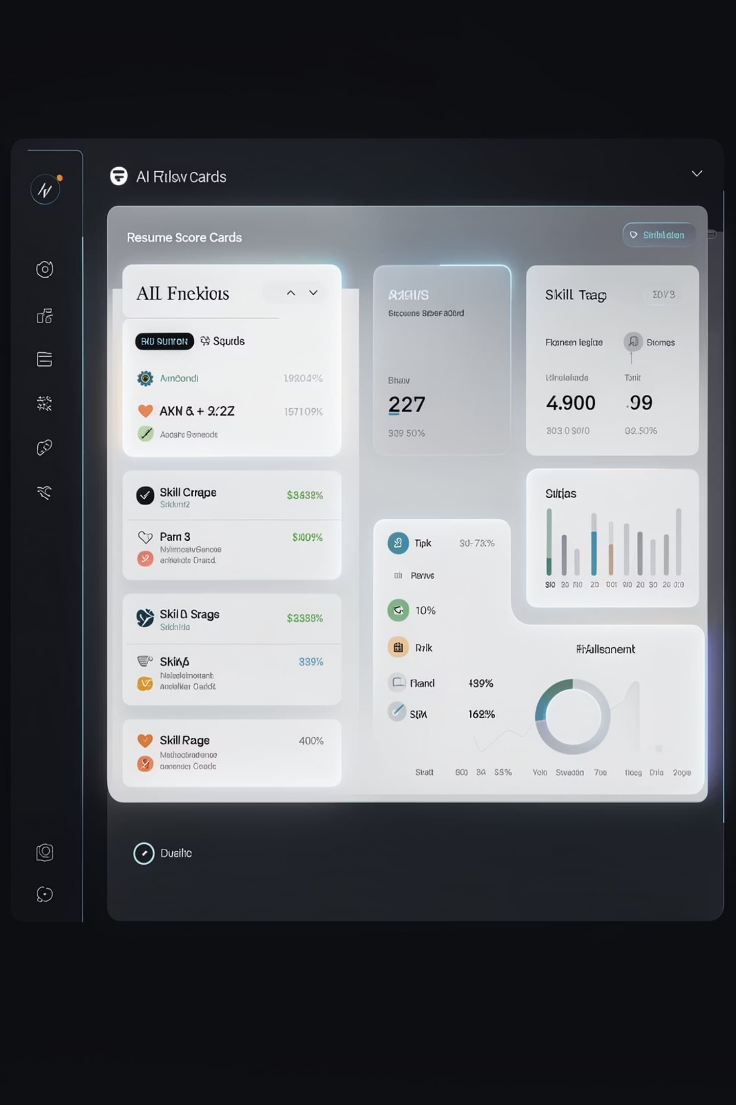
Key Features
For Candidates
AI Resume Analyzer · ATS Optimization · Rewrite Suggestions · Strength & Weakness · Missing Skills · Interview Questions · Certificate Analysis · Resume Score
For HR
Candidate Ranking · Language Translation · PDF Export · Comparison Dashboard

Slide 11






Innovation
One Platform, Two Worlds
Premium AI Experience
Single AI platform serving both Candidates and Recruiters
Professional UI · AI-generated recommendations · Automatic recruiter insights
Universal File Support
Multilingual AI
Supports PDF · DOCX · Images · Certificates
English & Hinglish — built for real-world diversity

